Slide 1

Building Responsive Website Using HTML, CSS
By:- Pramod Joshi
B.Tech.(CSE) - 2nd year
Graphic Era Hill University , Bhimtal(Nainital)
Notes:
Why we learn html

Slide 2
LEARNING OBJECTIVES / (AGENDA) :
Elements:
What is HTML?
HTML VS XHTML
HTML VS HTML5
HTML is a scripting language or not?
CSS(Cascading Style Sheets).
What is Domain and Hosting?
What is SEO?
What do you mean by Responsive?
conclusion:
How we build responsive web-page using HTML and CSS.

Slide 3
WHAT IS HTML?
Hypertext Mark-up Language (HTML) is the set of mark-up symbols or codes inserted into a file intended for display on the Internet.
The mark-up tells web browsers how to display a web page's words and images.
Each individual piece mark-up code (which would fall between "<" and ">" characters) is referred to as an element, though many people also refer to it as a tag. Some elements come in pairs that indicate when some display effect is to begin and when it is to end.

Slide 4
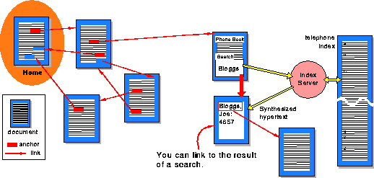
WHAT IS HYPERTEXT ?
Hypertext is text which contains links to other texts. The term was coined by Ted Nelson around 1965.
Hypermedia is a term used for hypertext which is not constrained to be text: it can include graphics, video and sound , for example. Apparently Ted Nelson was the first to use this term too.

Slide 5
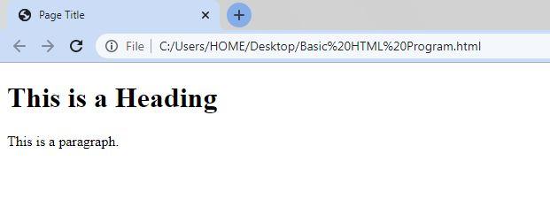
BASIC HTML PROGRAM:
Code:
Output:
<!DOCTYPE html>
<html>
<head>
<title>Page Title</title>
</head>
<body>
<h1>This is a Heading</h1>
<p>This is a paragraph.</p>
</body>
</html>

Slide 6
DOCTYPE IN HTML?
The HTML document type declaration, also known as DOCTYPE, is the first line of code required in every HTML or XHTML document. The DOCTYPE declaration is an instruction to the web browser about what version of HTML the page is written in. This ensures that the web page is parsed the same way by different web browsers.
DOCTYPE SYNTAX FOR HTML5 AND BEYOND:
<!DOCTYPE html>
DOCTYPE SYNTAX FOR TRANSITIONAL HTML 4.01:
<!DOCTYPE HTML PUBLIC "-//W3C//DTD HTML 4.01 Transitional//EN" "http://www.w3.org/TR/html4/loose.dtd">

Slide 7

HTML FORMATTING ELEMENTS
Formatting elements were designed to display special types of text:
<b> - Bold text.
<strong> - Important text.
<i> - Italic text.
<em> - Emphasized text.
<mark> - Marked text.
<small> - Smaller text.
<del> - Deleted text.
<ins> - Inserted text.
<sub> - Subscript text.
<sup> - Superscript text.
https://bit.ly/HTML_Tags

Slide 8

HTML LINKS - HYPERLINKS
<a href="url">link text</a>
The target Attribute:
https://bit.ly/HTML_Links
<a href="https://www.w3schools.com/" target="_blank">Visit W3Schools!</a>
The target attribute specifies where to open the linked document.
The target attribute can have one of the following values:
1. _self - Default. Opens the document in the same window/tab as it was clicked.
2. _blank - Opens the document in a new window or tab.
3. _parent - Opens the document in the parent frame.
4. _top - Opens the document in the full body of the window.

Slide 9
WHAT IS XHTML?
XHTML stands for Extensible Hypertext Mark-up Language.
XHTML is a stricter, more XML-based version of HTML.
XHTML is HTML defined as an XML(Extensible Mark-up Language) application.
XHTML is supported by all major browsers.
WHY XHTML?
XML is a mark-up language where all documents must be marked up correctly (be "well-formed").
XHTML was developed to make HTML more extensible and flexible to work with other data formats (such as XML). In addition, browsers ignore errors in HTML pages, and try to display the website even if it has some errors in the mark-up. So XHTML comes with a much stricter error handling.
For more info.:- https://bit.ly/HTML_VS_XHTML

Slide 10
WHAT IS HTML5?
HTML5 is the 5th version of HTML version 1.0 with support for more tags and features. Technically its termed HTML version 5.0, but colloquially it called HTML5.
The latest version of Browsers like Safari, Opera, Chrome, and Firefox supports all most all features of HTML5. A web developer can use HTML5 for developing photo sites, web forums, and advanced mapping applications. The Full form of HTML5 is Hypertext Mark-up Language 5.
FEATURES OF HTML5:
It supports local storage.
HTML5 has New content related elements, like, <header>, <footer>, <article>, etc.
It offers new form controls, like date, calendar, time, URL, email, and search.
Support for CSS3, the newer and version of CSS.
Provides media support.
Figure element can be combined with elements to easily associate a caption with the other image elements.
You can store large amounts of data locally without affecting site performance.
HTML is capable of handling incorrect syntax.
For more info.:- https://bit.ly/HTML_VS_HTML5

Slide 11
HTML IS A SCRIPTING LANGUAGE OR NOT?
HTML is actually a mark-up language and not a scripting language. Scripting implies decision making capabilities (the code can actually evaluate and take an action based on what it finds) – PHP, PERL, Ruby, JavaScript are examples of scripting languages. ... HTML.
A scripting language is a programming language that is interpreted. It is translated into machine code when the code is run, rather than beforehand. Scripting languages are often used for short scripts over full computer programs. JavaScript, Python, and Ruby are all examples of scripting languages.

Slide 12
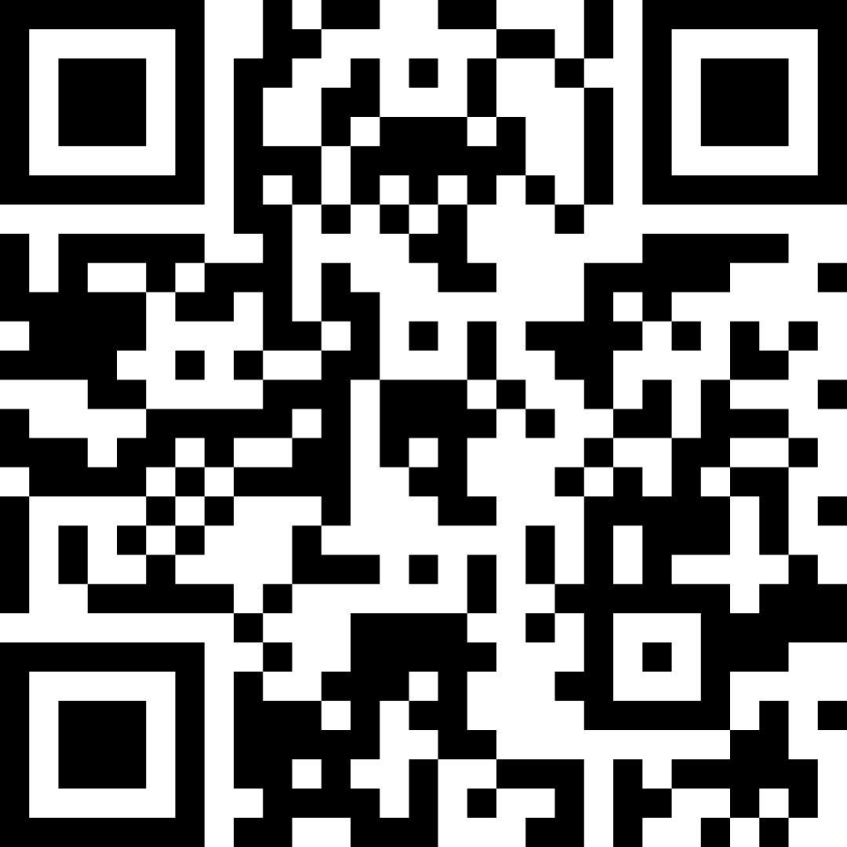
WHAT IS CSS?
https://bit.ly/HTML_CSS_TYPES
Cascading Style Sheets (CSS) is used to format the layout of a webpage.
With CSS, you can control the colour, font, the size of text, the spacing between elements, how elements are positioned and laid out, what background images or background colours are to be used, different displays for different devices and screen sizes, and much more!
Note: The word cascading means that a style applied to a parent element will also apply to all children elements within the parent. So, if you set the colour of the body text to "blue", all headings, paragraphs, and other text elements within the body will also get the same colour (unless you specify something else)!

Slide 13
WHAT IS DOMAIN ?
A domain name is a string of text that maps to a numeric IP address, used to access a website from client software. In plain English, a domain name is the text that a user types into a browser window to reach a particular website. For instance, the domain name for Google is ‘google.com’.
The actual address of a website is a complex numerical IP address (e.g. 103.21.244.0), but thanks to DNS, users are able to enter human-friendly domain names and be routed to the websites they are looking for. This process is known as a DNS(Domain Name System) lookup.
For more info.:- https://bit.ly/domain_html

Slide 14
WHAT IS HOSTING ?
A web hosting service is a type of Internet hosting service that hosts websites for clients, i.e. it offers the facilities required for them to create and maintain a site and makes it accessible on the World Wide Web. Companies providing web hosting services are sometimes called web hosts.
The host may also provide an interface or control panel for managing the Web server and installing scripts, as well as other modules and service applications like e-mail. A web server that does not use a control panel for managing the hosting account, is often referred to as a "headless" server. Some hosts specialize in certain software or services (e.g. e-commerce, blogs, etc.).
Web Hosting Platforms:- Hostinger, Wordpress, Blogger, Etc.
For more info.:- https://bit.ly/Hosting_html

Slide 15
WHAT IS SEO?
Search engine optimization (SEO) is the art and science of getting pages to rank higher in search engines such as Google. Because search is one of the main ways in which people discover content online, ranking higher in search engines can lead to an increase in traffic to a website.
SEO works by optimizing your site for the search engine that you want to rank for, whether it's Google, Bing, Amazon or YouTube. ... (For example, Google has over 200 ranking factors in their algorithm.) In most cases, when people think “search engine optimization”, they think “Google SEO”

Slide 16
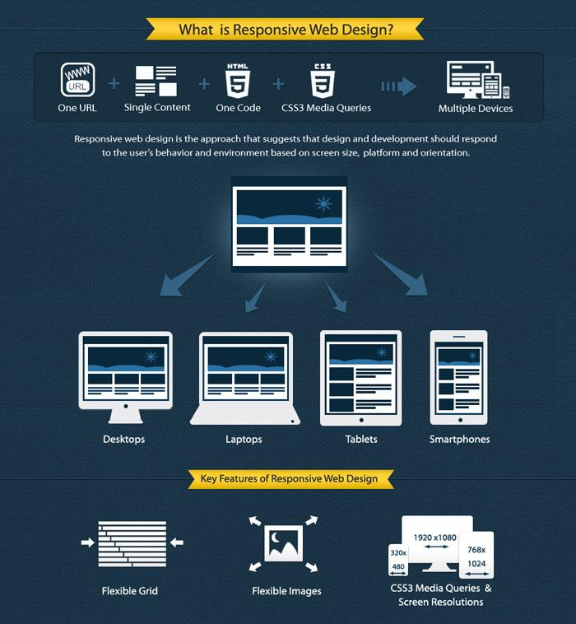
RESPONSIVE WEB DESIGN (RWD)
Responsive web design (RWD) is an approach to web design that makes web pages render well on a variety of devices and window or screen sizes from minimum to maximum display size. Recent work also considers the viewer proximity as part of the viewing context as an extension for RWD. Content, design and performance are necessary across all devices to ensure usability and satisfaction.
responsive web design has become more important as the amount of mobile device user has come to account for more than half of total internet traffic. In 2015, for instance, Google announced Mobilegeddon and started to boost the ratings of mobile-friendly sites if the search was made from a mobile device. Responsive web design is an example of user interface plasticity.
Notes:
Js meta tags used for RWD.

Slide 17
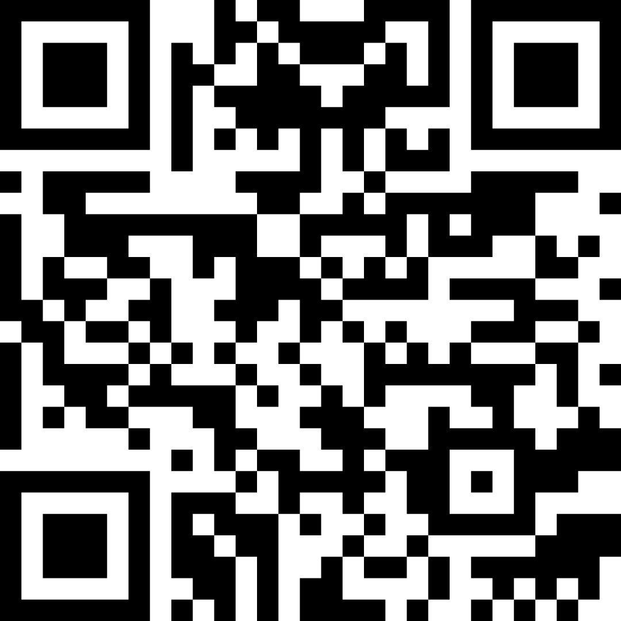
HOW WE BUILD RESPONSIVE WEB-PAGE USING HTML AND CSS
https://bit.ly/coding_with_fun

Slide 18

Thanks for giving
your auspicious Time.

